Slide 1
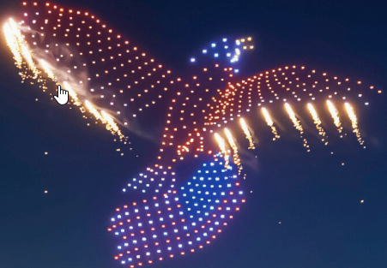
ECO-Friendly Fireworks: The Future of Aerial Shows
Sustainable • Profitable • Technologically Advanced
Adel Ramezani | Automation
Mühlbauer, Germany

Slide 2
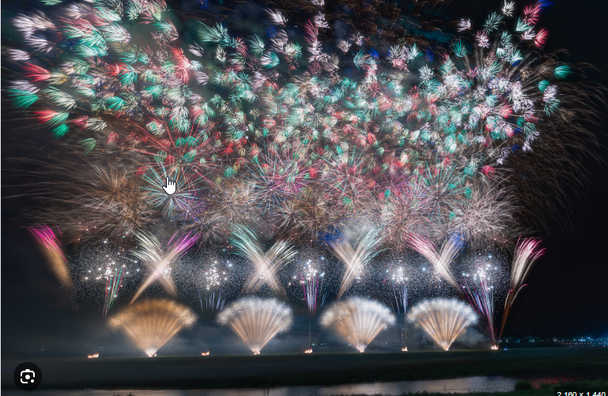
The Problem with
Traditional Fireworks
🌫️ Pollution: Air and noise emissions
🔥 Safety Risks: Fire hazards and injuries
💸 Single Use: High cost, no reuse
🧩 Sustainability Pressure: Cities seeking eco alternatives

Slide 3
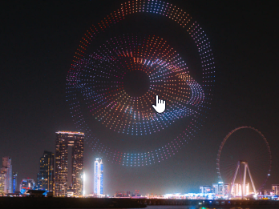
Our Solution: Drone-Based
Aerial Animation Shows
♻️ Eco-friendly and reusable
💡 Programmable animations synchronized with music
💻 Controlled via intelligent choreography software
🎇 Visually stunning, customizable for any event

Slide 4
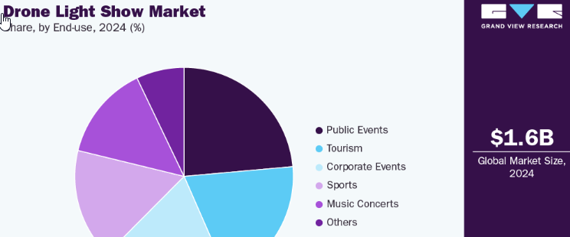
Market Opportunity
🇩🇪 Over 2,000 German cities host annual fireworks
🎡 160–180 national & international trade fairs yearly
💶 European drone show market exceeds €100M
📈 Strong export potential with 'Made in Germany' quality

Slide 5
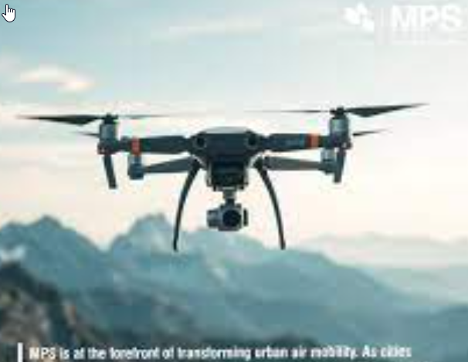
Why Our Company
Is the Right Starting Point
⚙️ Expertise in industrial automation and robotics
🧠 Skilled engineering & software teams
🏭 Existing manufacturing infrastructure
🤝 Strong supplier and distribution networks

Slide 6
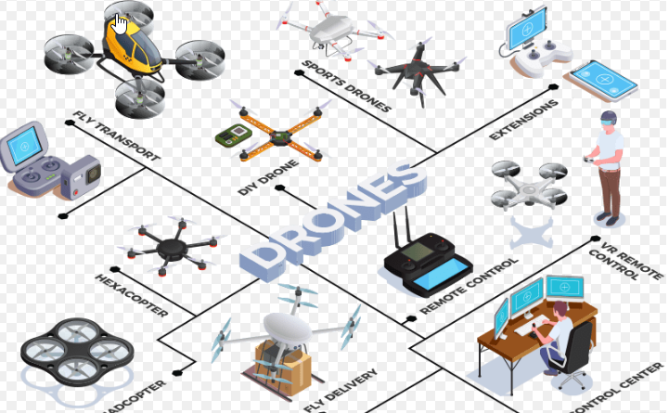
Project Structure
📈 Marketing & Business Development
💻 Drone Choreographing Software
🚁 Drone Production Line
All three divisions operate synchronously and
support each other.

Slide 7
Implementation Roadmap
Phase 1 (0–6 months): Pilot project with 100 drones
Phase 2 (6–18 months): Develop German-made
drone and software
Phase 3 (18–36 months): Scale production and
go international

Slide 8
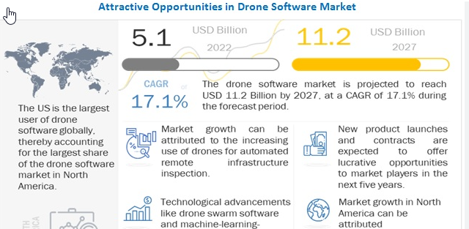
Financial Outlook & ROI
💶 Initial Investment: €500k–€1M
📊 Revenue Streams: Shows, Software Licensing,
Drone Sales
📈 Payback Period: 2–3 years
🔁 Long-term profitability via reusability & service model

Slide 9
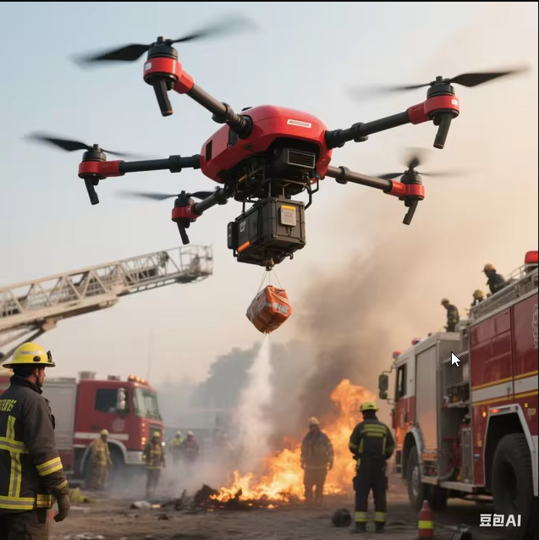
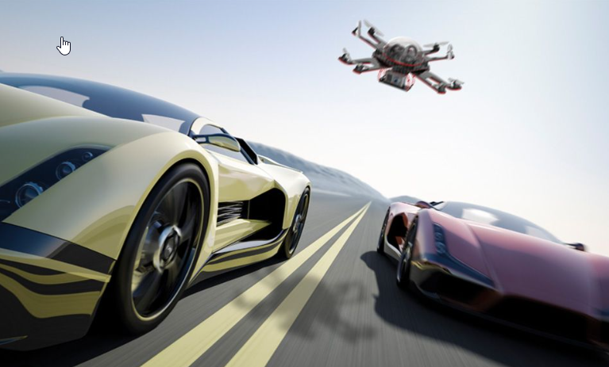
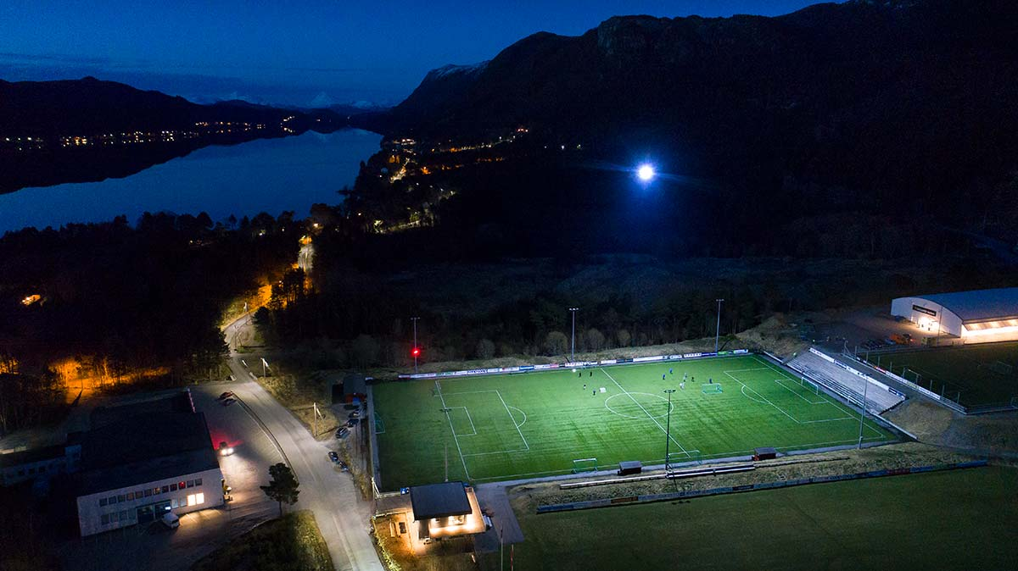
Future Expansion Potential
🎥 Cinematography drones
🚨 Public safety and rescue drones
🌾 Agricultural monitoring drones
📦 Logistics & transport drones
🧒 Educational drones for kids
🧩 Sell components and accessories

Slide 10
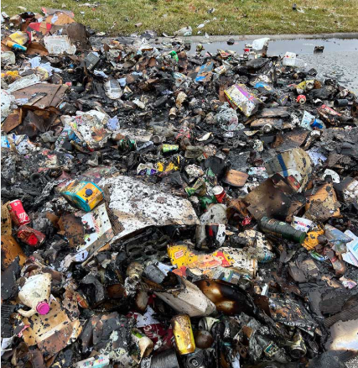
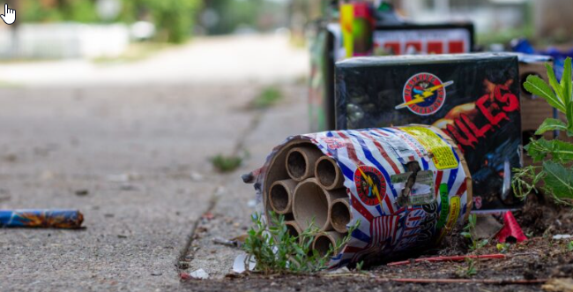
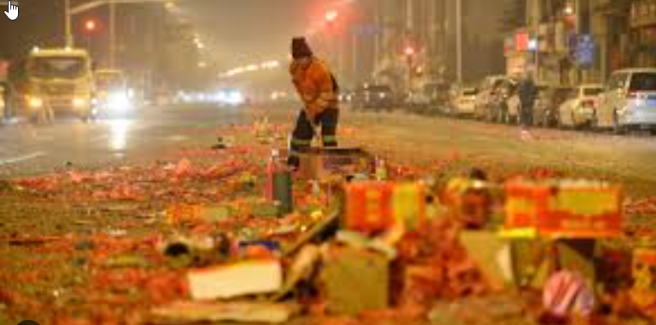
Environmental & Brand Impact
🌱 Zero pollution, zero waste
🔋 Fully reusable systems
🇩🇪 German engineering excellence
🌍 Strong sustainability and CSR positioning

Slide 11
Next Steps
✅ Approve pilot feasibility study
🤝 Form cross-department task force
📍 Partner with one municipality
📅 Define milestones and KPIs

Slide 12
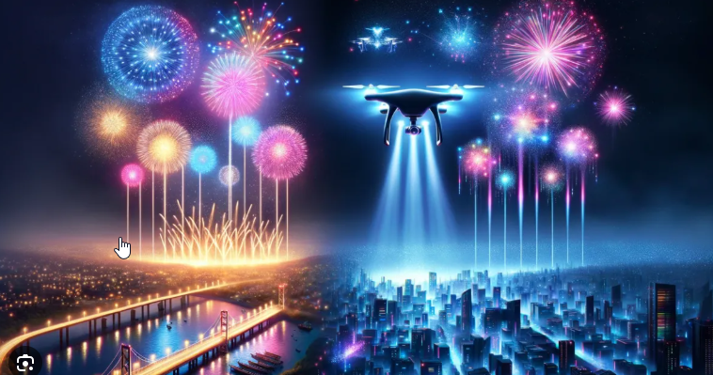
Conclusion
✨ Reinventing the Sky — Sustainably ✨
Combining German engineering with innovation
for eco-friendly entertainment.
Let's make the future of fireworks — Made in Germany.

